Slide 1
Jenkins, SonarQube, Nexus
Create/Install Jenkins Server as per document
Create/Install SonarQube Server
Create/Install Nexus Artifactory Tool
Do Integration of SonarQube and Nexus with Jenkins

Slide 2
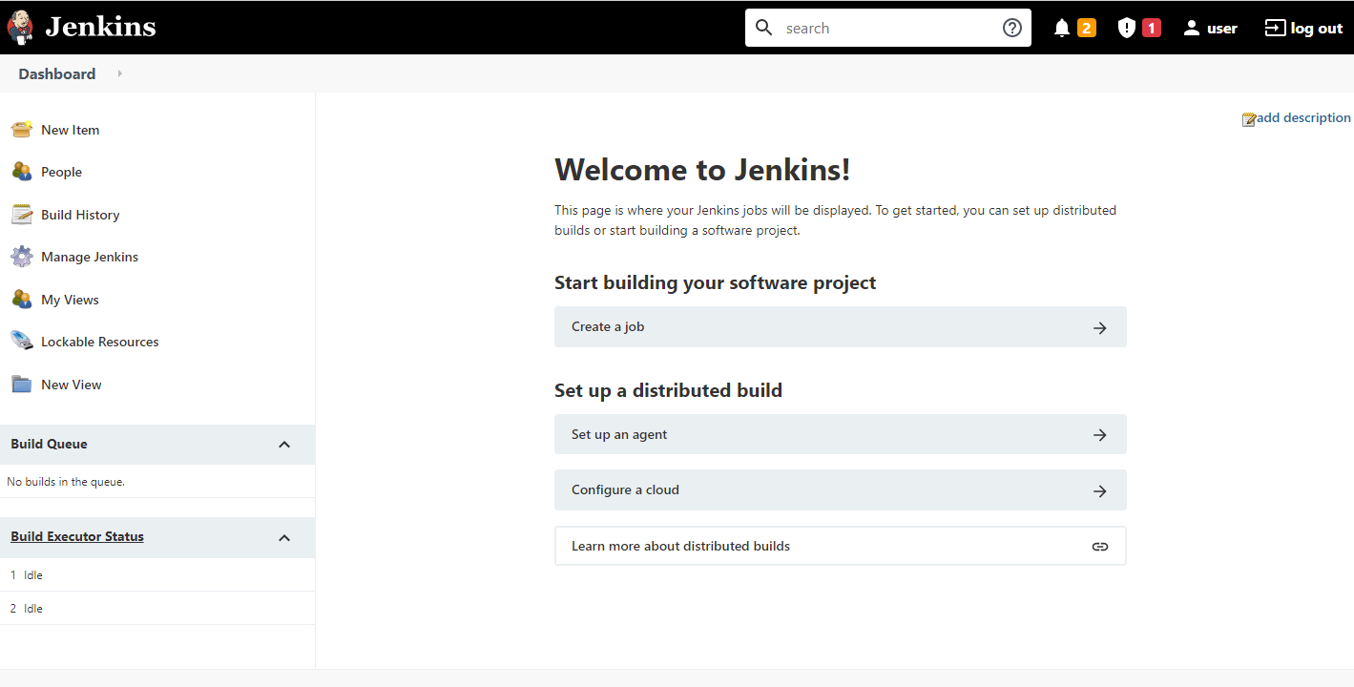
AMI IMAGE MARKETPLACE - JENKINS

Slide 3
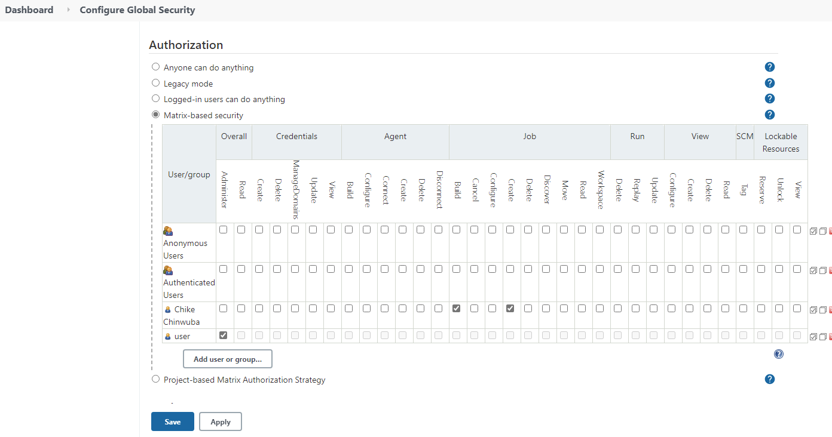
AUTHORIZATION - JENKINS

Slide 4
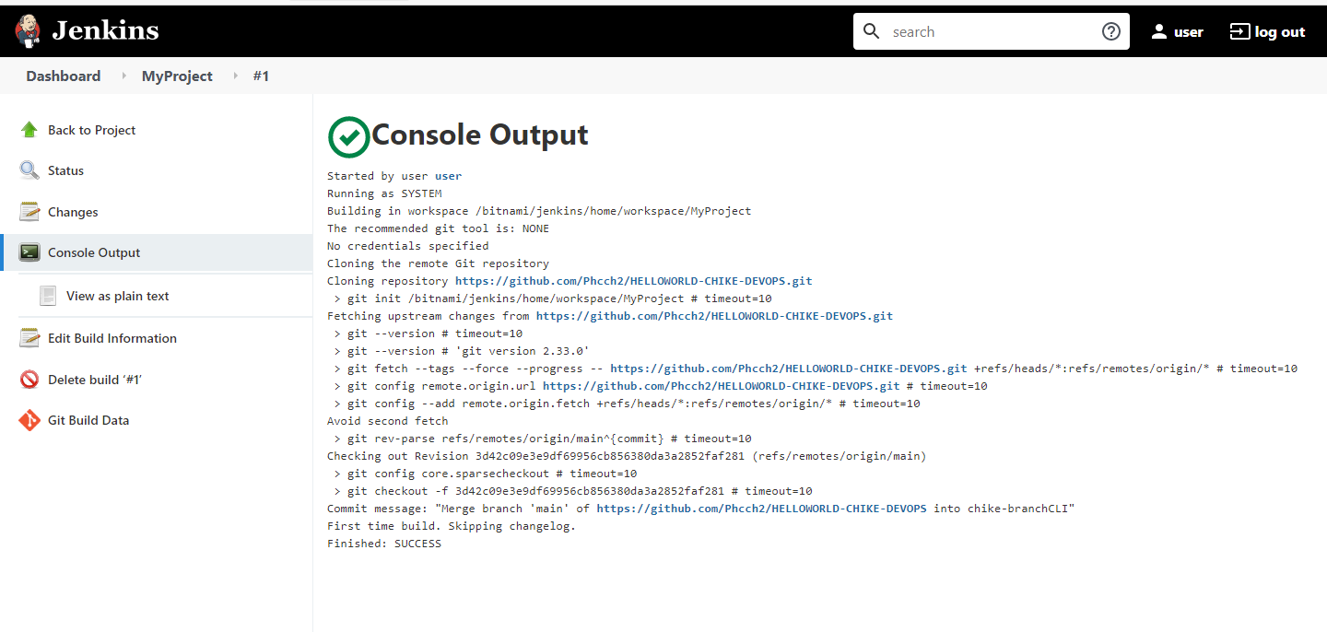
BUILD RUN – CONSOLE OUTPUT MyProject

Slide 5
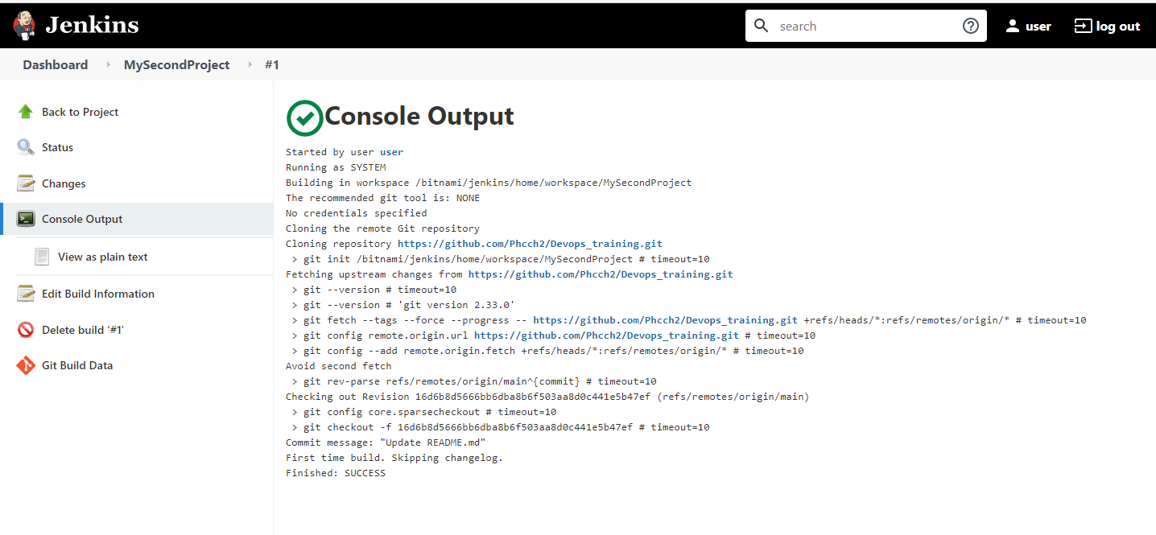
BUILD RUN – CONSOLE OUTPUT - MysecondProject

Slide 6
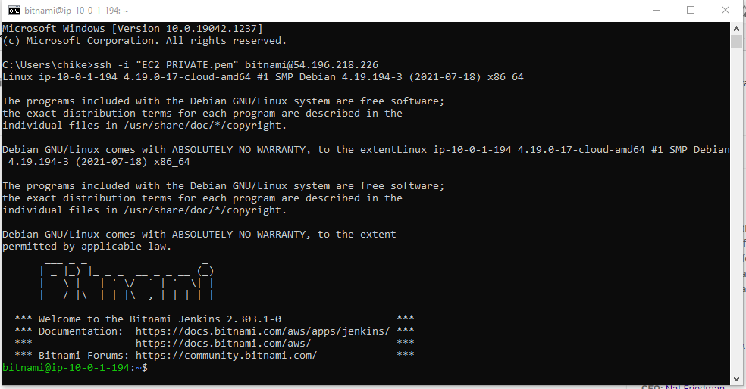
BITNAMI CLI CONNECTION

Slide 7
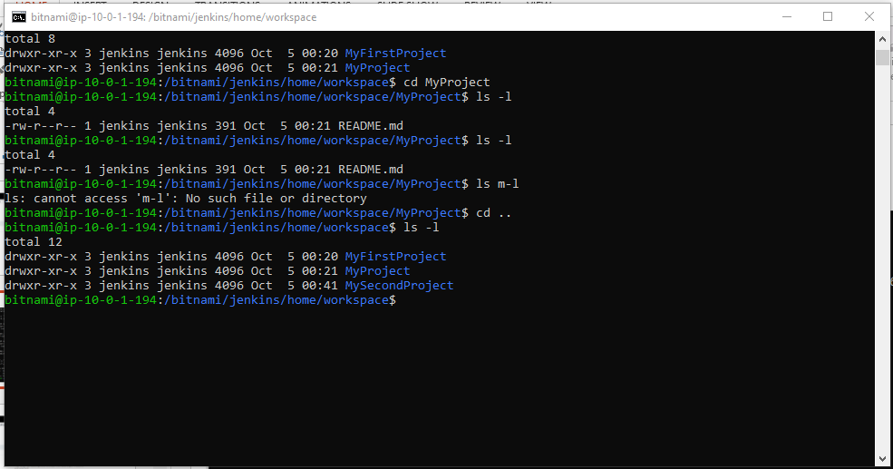
BITNAMI CLI Output - Projects

Slide 8
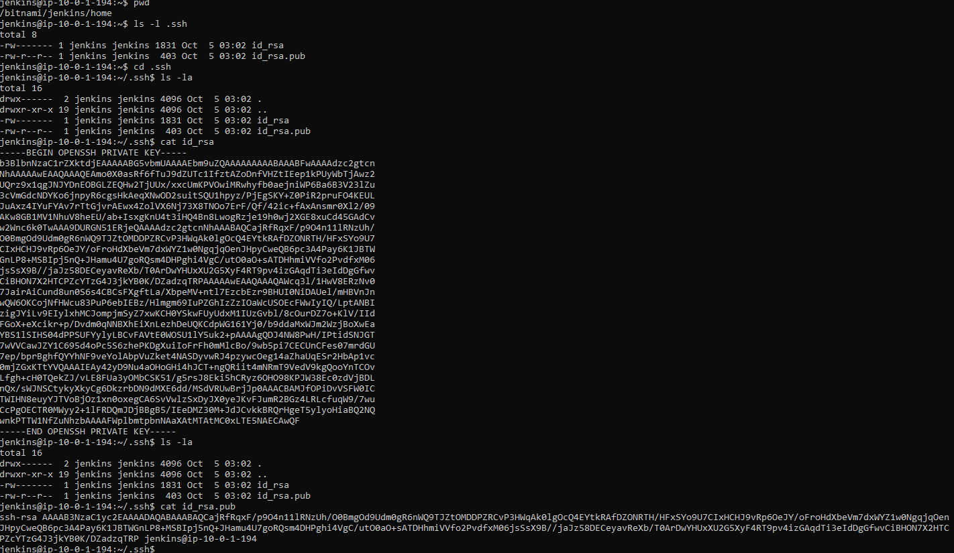
SSH Keys – Public & Private

Slide 9
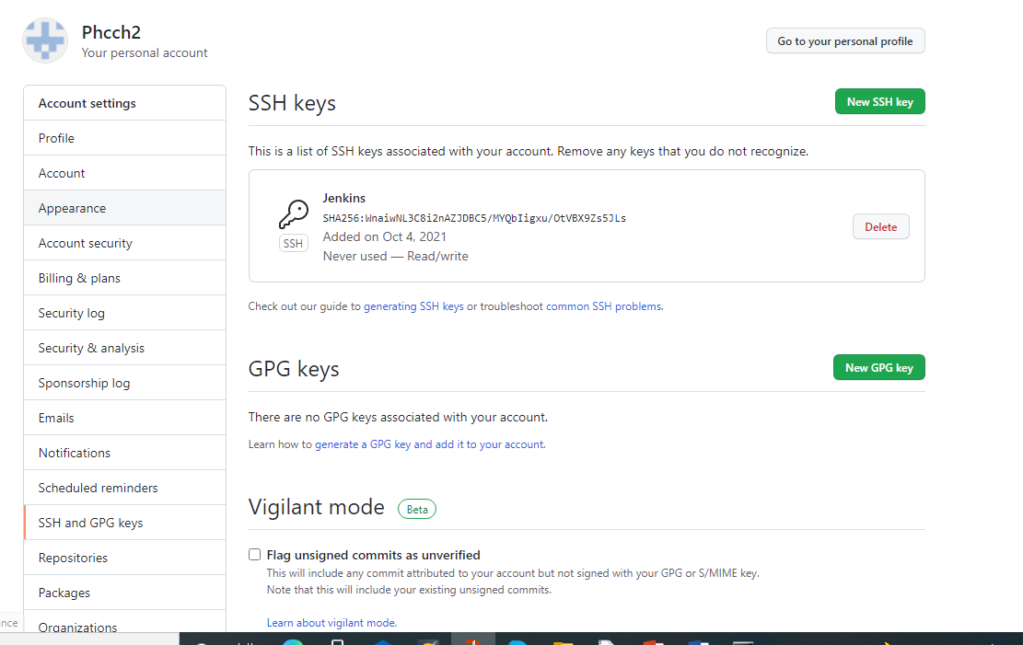
Github Clone Key Replacement

Slide 10
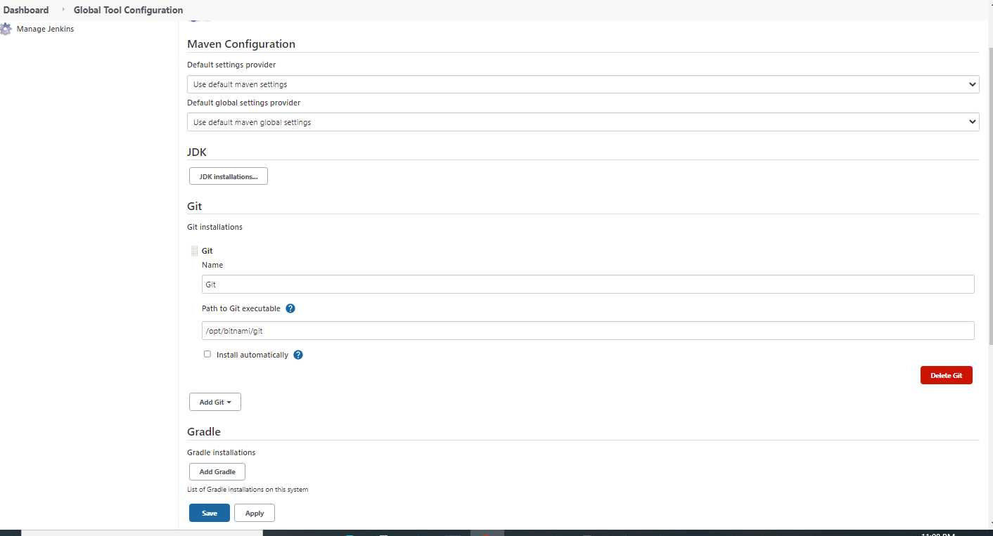
JAVA & GIT CONFIGURATIONS

Slide 11
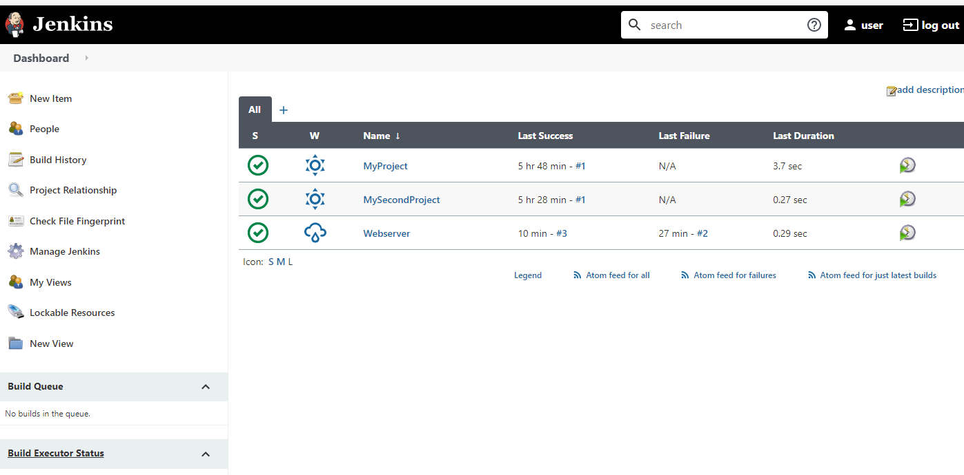
WEBSERVER PROJECT

Slide 12
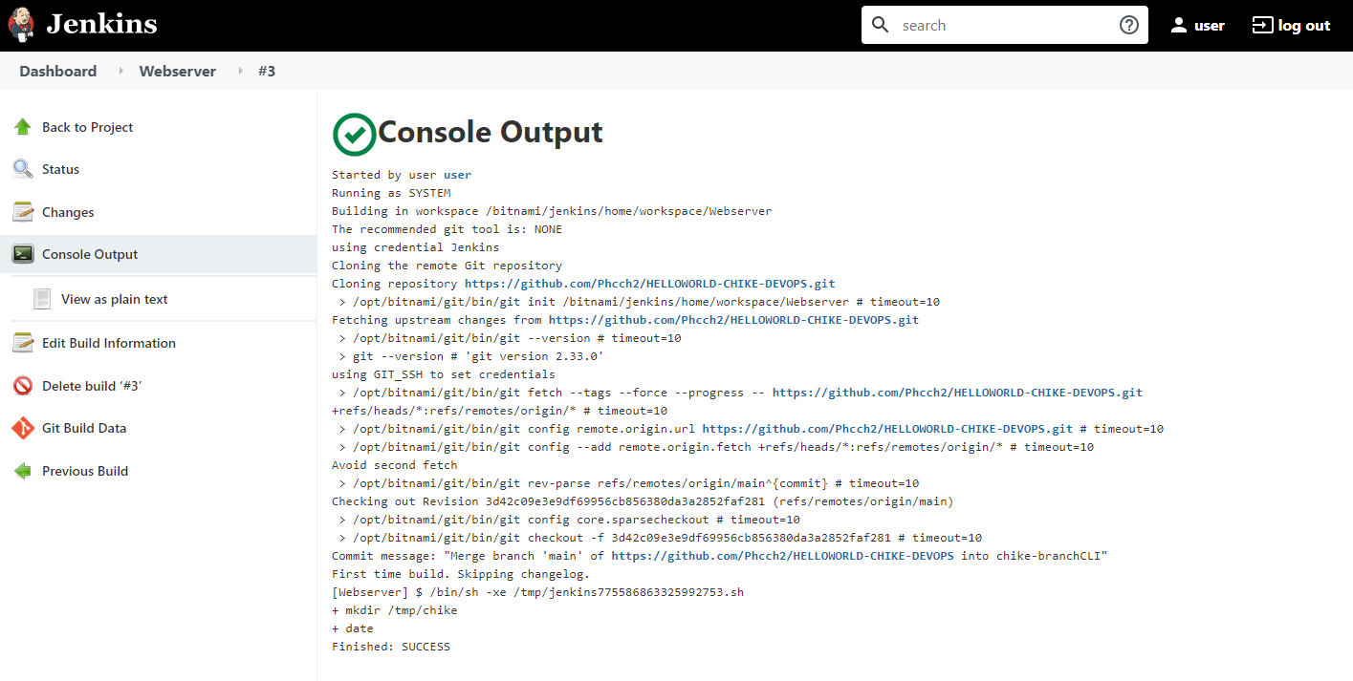
WEBSERVER PROJECT – CONSOLE OUTPUT

Slide 13
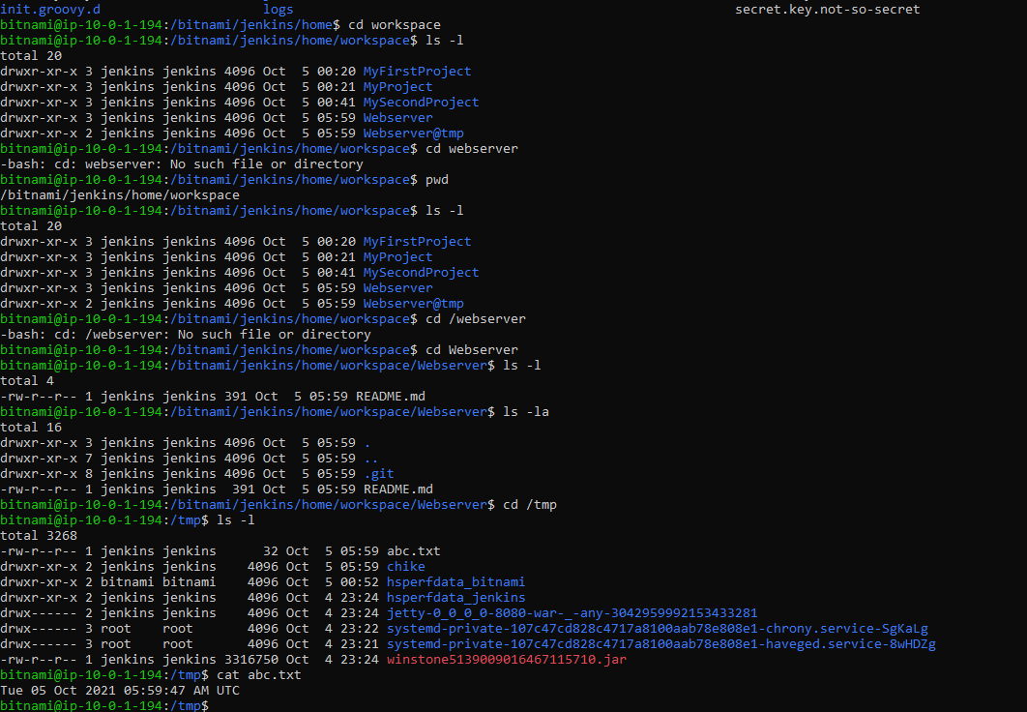
Command line script automation

Slide 14
Jenkins, SonarQube, Nexus
Create/Install Jenkins Server as per document
Create/Install SonarQube Server
Create/Install Nexus Artifactory Tool
Do Integration of SonarQube and Nexus with Jenkins

Slide 15
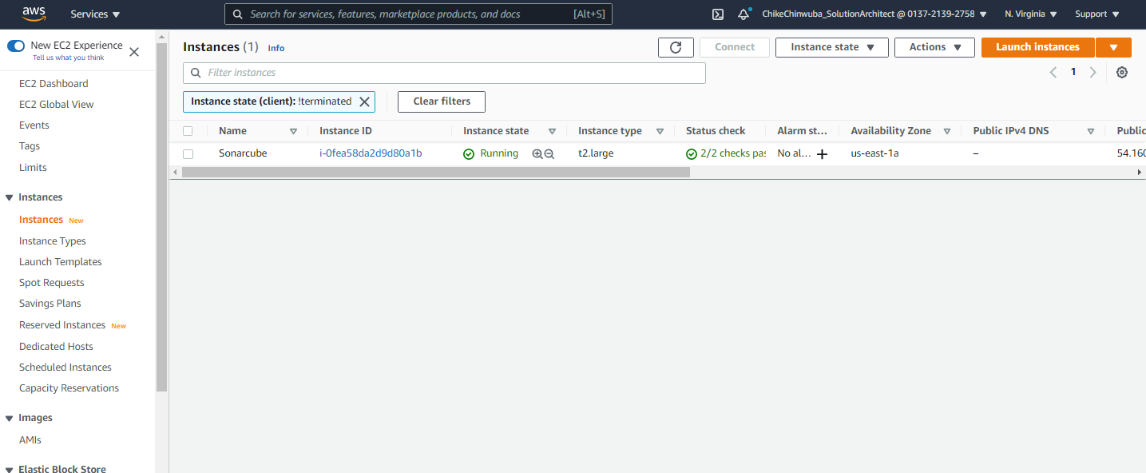
SONARCUBE INSTANCE

Slide 16
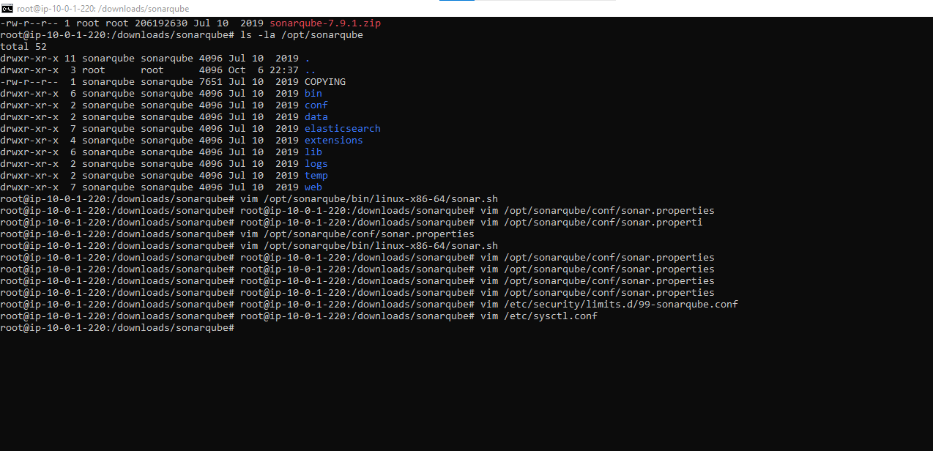
VIM on configuration files

Slide 17
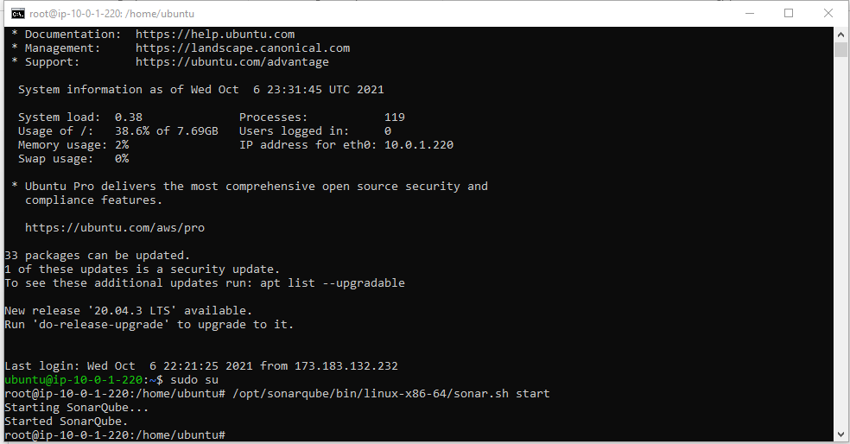
Sonarqube started on CLI

Slide 18
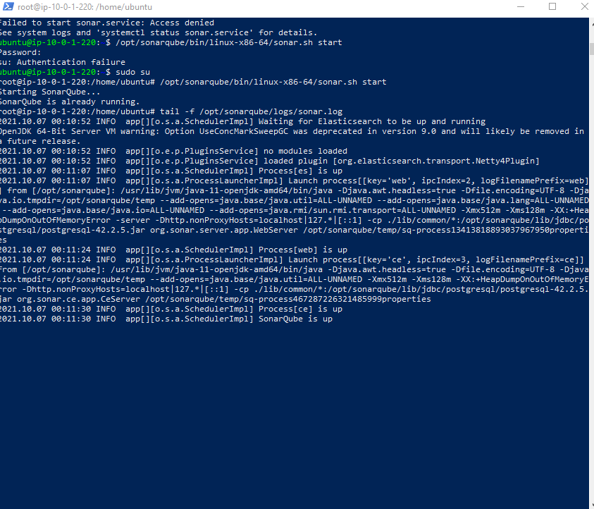
Tail –f - File Not running on URL http://<.....>:9000

Slide 19
Jenkins, SonarQube, Nexus
Create/Install Jenkins Server as per document
Create/Install SonarQube Server
Create/Install Nexus Artifactory Tool
Do Integration of SonarQube and Nexus with Jenkins

Slide 20
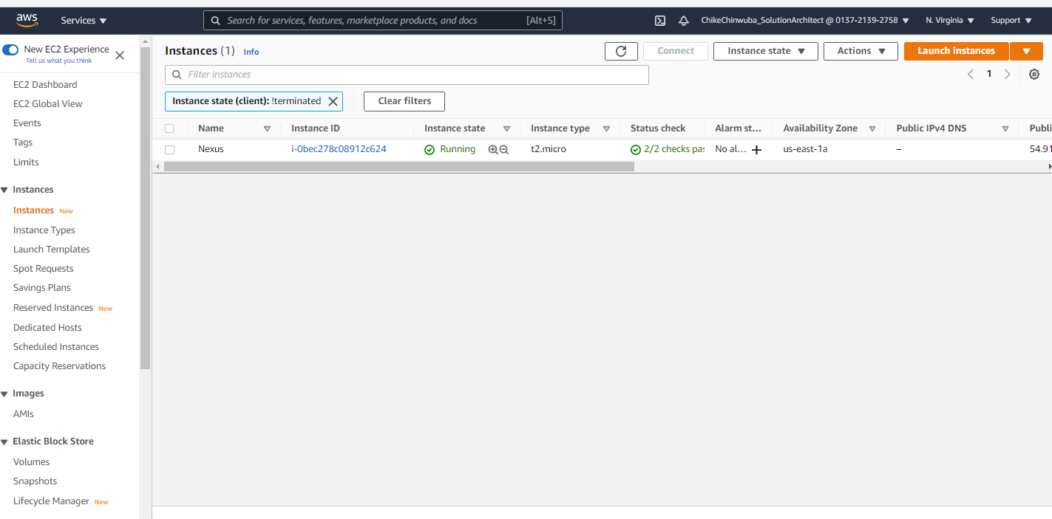
Nexus Instances

Slide 21
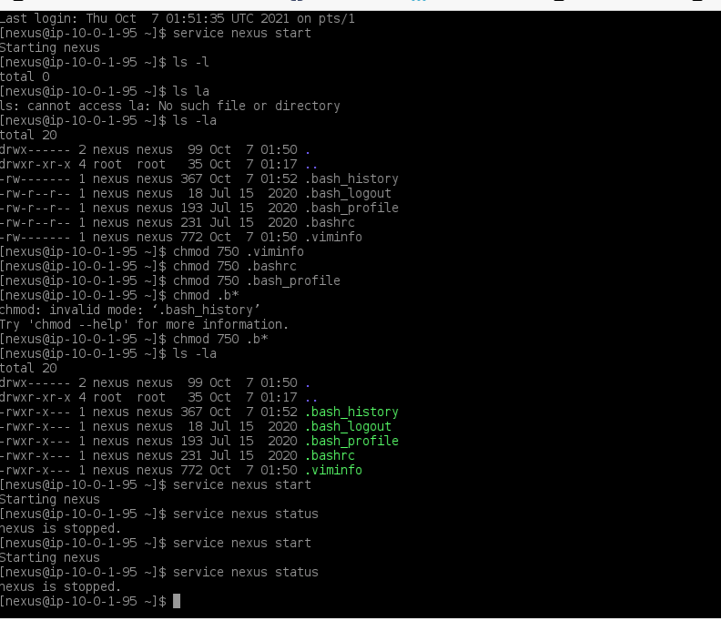
Nexus Started and Stopped

Slide 22
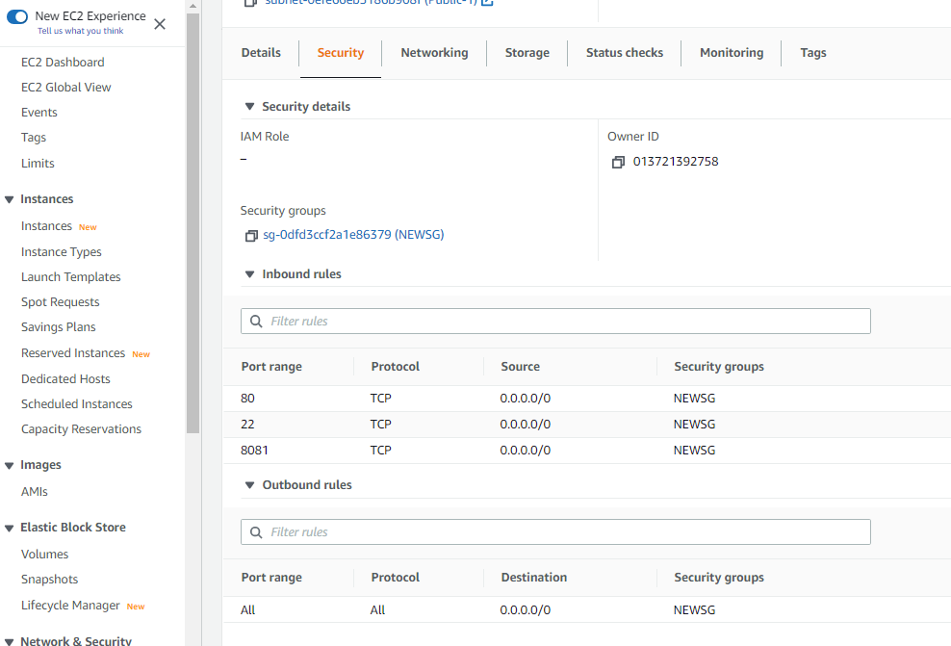
Nexus NOT RUNNING – PORT 8081 ADDED TO SG

Slide 23
Jenkins, SonarQube, Nexus
Create/Install Jenkins Server as per document
Create/Install SonarQube Server
Create/Install Nexus Artifactory Tool
Do Integration of SonarQube and Nexus with Jenkins

